Slide 1
Software Design Methods and Techniques
Lecture 2
Prof. Hong Zhu
Dept of Computing and Communication Technologies

Slide 2
Today’s Lecture
What is design?
Characteristics of design activity
Elements of designs
Factors that effect designs
Nature of design problems
How to make designs?
General principles of software design
Design process
Design strategies
Design methodologies

Slide 3
Review: Major Causes of Difficulties in SD
Complexity. It is an essential property of software.
Conformity. Software is expected to conform to the standards imposed by other components, such as hardware, or by external bodies, or be existing software.
Changeability. Software suffers from constant needs of changes.
Invisibility. Any forms of representations that are used to describe software will lack any form of visual link that can provide an easily grasped relationship between the representation and the system.
Brooks, F. P. Jr,
No silver bullet: essence and accidents of software engineering,
IEEE Computer, 1987, pp10~19.

Slide 4
Dealing With Complexity
Witt, Baker & Merritte’s Axioms
These axioms are about the relationships between design activities and the affect on outcomes.
They address a specific issue of design, i.e. how to deal with complexity. Two vehicles are identified and their properties are stated.
Separation of concerns:
identifying a specific design concern and separating it from the rest during design process
Abstraction:
identifying the most important issues and ignoring the less important details

Slide 5
Axioms about separation of concerns
The Axiom of Comprehension:
The mind cannot easily manipulate more than about seven things at a time.
The Axiom of Separation of Concerns:
A complex problem can best be solved by initially devising an intermediate solution expressed in terms of simpler independent problems.

Slide 6
Axioms about abstraction
The Axiom of Translation:
Design correctness is unaffected by movement between equivalent contexts.
The Axiom of Transformation:
Design correctness is unaffected by replacement of equivalent components.

Slide 7
General Principles of Software Design
Based on the previous axioms, Witt, Baker & Merritte (1994) proposed a set of objectives of software design. These objectives can be regarded as the general guideline for software design.
Objective 1: Modularity
The design should be composed of replaceable, self-contained assemblies of elementary parts, thereby aiding both the initial development and the later maintenance.

Slide 8
Objective 2: Portability
Individual parts of the design, as well as the design as a whole, should be capable of reuse in different environments. The designed product should be able to be moved unchanged from test environments to operational environments, and from one operational environment to another.

Slide 9
Objective 3: Malleability
The design should facilitate adaptation to changing end-user requirements, for example, changes based on new problems in the end user’s world, the discovery of a need for information not previously anticipated or included in the original specifications.
Malleability also known as modifiability and flexibility as a quality attribute of software systems.

Slide 10
Objective 4: Conceptual integrity
The design should exhibit harmony, symmetry and predictability. The system should appear to reflect the mind of a single person, and to faithfully adhere to a single concept. There should be no surprises for its user or its maintainer; knowledge gained in one use or change should be immediately transferable to the next.

Slide 11
Intellectual Control
The design process should be under intellectual control. An evolving design is under intellectual control if, despite its complexity, it is deeply understood by those responsible for its correctness; they have mastery of its form and content. Managers may understand cost and schedules; but those responsible for the design itself must understand the manner in which the parts interrelate, the rationale and criticality of design choices, and effect of proposed change.
This property is neither a product-oriented quality attribute, nor a process-oriented quality attribute. It should be considered as as a good guideline for how to make a good design.

Slide 12
How to Achieve Design Objectives
The principle of modular designs:
Modularity can be achieved by
dividing large aggregates of components into units having loose inter-unit coupling and high internal cohesion,
abstracting each unit’s behaviour so that its collective purpose can be known
defining each unit’s interface so that it can be employed without internal details, and
hiding its internal design details so that it can be changed without affect its functionality.

Slide 13
(2) The principle of portable designs:
Portability can be achieved by employing abstract context interfaces.
Standardisation of platform interface by a general model
Separation of application’s interface with the platform from the computations
Implementation of the interface part of applications using the standardised model of platform interface
For example, ISO’s communication protocol standard defines such an abstract model that is independent of the platform.

Slide 14
(3) The principle of malleable designs: Malleability can be achieved with designs that model the end-user’s view of the external environment.
For example, in object-oriented development, the structure and behaviour of an information system should reflect the structure and behaviour of the real world system. Therefore, the changes in the users’ requirements can be naturally reflected as changes in the computerised information system.

Slide 15
(4) The principle of conceptual integrity: Conceptual integrity can be achieved by the uniform application of a limited number of design forms.
This means not to mix up many different things together.
Simplicity helps to achieve conceptual integrity.

Slide 16
(5) The principle of intellectual control:
Intellectual control can be achieved by recording designs (after developing a design strategy) as hierarchies of increasingly detailed abstractions.

Slide 17
Design Processes
Involve a wide range of activities, which consists of at least four aspects
the action carried out in the activity
the participants
the input information
the output or the result of the action
Process model
the activities involved in the design process
the interrelationships between the activities
Generic process models
apply to the design of all kind of products.
Specific Process models apply to specific types of systems
Software process model: for software development and design
Safety system lifecycle: for safety related systems
There are also other aspects, such as the conditions and constraints on which the activity to be carried out.

Slide 18
A Generic Process Model of Designs
External requirements
Identify nature of requirements
Requirements specification
Descriptive modes:
Describe what designers do in design.
Analyse & build model of problem
Specification/ comparison criteria
Specification
Specification
New Constraints
Designer’s models
Postulate design solution(s)
Seek new solution
Mismatches between model and requirements
Compare solutions
Revise design solution
Validate each solution
Seek new solutions
Designer’s model
Selected design solution
Validated model
Designer’s model
Elaborate solution
‘Blueprint’

Slide 19
Software Design Stages
requirements
Architectural design
the structure, i.e. the composition of components;
the global control structures;
the protocols for communication, synchronisation, and data access;
the assignment of functionality to components;
physical distribution;
scaling and performance;
the dimensions of evolution;
the selection among design alternatives.
Detailed design
the data structures and the algorithms for each component
the details of the user interface, and input/output formats,
the selection of language, libraries and development tools.
Architectural Design
Software architecture
Detailed Design
Module design

Slide 20
Design Strategies
A design strategy is used in a design method to guide the process of building up design models.
Decompositional design – top-down
Compositional design – bottom-up
Design patterns – reuse of designs
Evolutionary design – trial and error
Each design strategy can be considered as a prescriptive design process, which are
Guidelines for the creation of designs
Ideal processes that usually lead to good designs

Slide 21
Decompositional Methods
Overall design problem
Decompose design problem
P₂
P₁, P₂ and P₃ are sub-problems
P₁
P₃
Solve sub-problems
S1, S2 and S3 are solutions for sub-problems P₁, P₂ and P₃, respectively
S₂
S₁
S₃
Assemble sub-solutions
Overall design solution

Slide 22
Process of Decompositional Methods
Decompositional methods take a top-down approach to the design process.
It starts with an original description of the problem or a model of the original problem.
The original problem is, then, decomposed into a number of sub-problems.
These sub-problems are then solved separately.
The sub-problem is solved directly if possible; Or
If a sub-problem is still too complicated to be solved directly, it is further decomposed.
The solutions of the sub-problems are put together to form a solution of the original problem.

Slide 23
Compositional Methods
Design problem
Identify elements in the model
Classify and group elements into components
Assemble components into system

Slide 24
Process of Compositional Methods
Compositional strategy is a bottom-up approach.
It starts with identifying a set of particular entities or objects involved in the problem.
These entities and objects are described, classified and grouped.
For each group, the relationships between the entities are identified so that links between entities are established. Such groups form the components of the model.
These components are further classified and grouped. The relationships between the components are identified to make larger components.
This composition process continues until a complete model is built.

Slide 25
Design Patterns and Design Reuse
Certain types of design problems in certain application domains may have a great deal of similarities in the design solutions that are proved to be good designs.
Common structures and other design features are abstracted into a template of designs.
Once a problem is identified to be an instance of such a class of problems, the design template can be instantiated and a good design can be relatively easily obtained.
Such a template is called a design pattern.
The use of design pattern is a reuse of design.

Slide 26
Evolutionary Design
Design problem
Divide design problems into groups
Design problem
G₂
G₄
Group G₁
G₃
Solution 1 solves G₁
Solution 2 solves G₁ and G₂
Solution 3 solves G₁, G₂ and G₃
Solution 4 solves all

Slide 27
Process of Evolutionary Design
Trial-and-error is perhaps the most basic approach to all designs.
It involves the creation of a design and evaluation of the design against the requirements and constraints.
If some requirements and/or constraints are not satisfied, the design is modified and a new design, even new designs, is created.
The cycle of creation and evaluation stops until a satisfactory design is obtained.
However, there is no guarantee that a satisfactory design can always be obtained.
Example of software evolutionary design methods:
Program transformation

Slide 28
Design Methodology
Representation: consists of one or more forms of notations to describe and/or model both the structure of the initial problem and that of the solution. It should also facilitate the analysis of the model.
Process: describes the procedures to follow in developing the solution and the strategies to adopt in making choices.
Heuristics: provides guidelines on the ways in which the activities defined in the process part can be organised for specific classes of problems.
How to describe a design model?
Representation
Process
Heuristics
How to adapt the model to particular types of problem?
What to do to produce the design model?

Slide 29
Well-Known Software Design Methods
Jackson Structured Programming and Jackson System Development (JSP & JSD) methods;
Structured methods: e.g. SSA/SD, SADT and SSADM;
Object-oriented and Object-based methods:
HOOD
More recent developments in the UML and united process;
OO design patterns
Formal methods:
Model-oriented formal specification methods,
axiomatic and algebraic formal specification methods,
refinement calculus,
formal proof methods,
program transformation methods, etc.
Software architectural styles
Component based software design
Software product lines
Catalogue of software architectural styles

Slide 30
Overview of JSP: Representation
Jackson Structure Diagram (also known as entity-lifecycle diagram)
Print bank statement
repetition
*
Print pages
Print page head
Print page body
Print page summary
*
optional
Print a/c transactions
Print date
Print details of transaction
Print amount of transaction
Print in debit column
Print in credit column

Slide 31
Overview of JSP: Design Process
Identify operations and allocate
Requirements document
Construct data structure diagrams for input and output
Program Structure Diagrams
Data Structure Diagrams
Transform to text
verify program structure against data structure
Program text
Merge data structure diagrams into program structure diagram
Add conditions
Program Structure Diagrams
Program text

Slide 32
Overview of JSP: Heuristics
Applicable application domain:
Batch processing of large sequences of data
Program structure in the dataflow architectural styles, such as pipe-and-filter style.
Heuristic rules to deal with difficult problems
Read-ahead:
Solution to the situations when there is a need to read-ahead of an element in the sequence of data to decide what to do to process the current element
Backtracking:
Solution to the situations when there is a need to go back to a previously processed element and change the decision made earlier
Program inversion and structure clashes
Solution to situations when the input and output data structure cannot be easily mapped into a program structure.

Slide 33
Overview of SSA: Representation (1)
Data flow diagram:
External entity
Process
Data flow
Data store

Slide 34
Overview of SSA: Representation (2)
Entity-relationship diagram
Multiplicity of the relation
Relation
Entity
Attribute

Slide 35
Overview of SSA: Representation (3)
Structure chart
Process
(procedure)
Direction of information flow
A
x
Call relationship
y
B
C
D
E
F
State transition diagram
Data dictionary
A list of data name, type and meanings

Slide 36
Overview of SSA: Design Process
Requirements Document
Construct initial DFD (context diagram)
Data analysis
ERD +
Data dictionary
DFD diagram
Refine DFD
Transaction analysis
State transition diagram
DFD diagram
Transformation analysis
Structure chart

Slide 37
Overview of SSA: Heuristics
Applicable application domain:
Database centred information systems
Heuristics rules
Mostly occur as consistence constraints during refinement of DFD
For example, every dataflow into or out a process must also be in the DFD diagram at the immediate lower level that refines the process.

Slide 38
Overview of OO Design: Representation
UML
Structural model:
Class diagram/object diagram
Component diagram
Describes how classes are packaged into components
The interfaces between components
The connections between components
Deployment diagram
Describes how components are deployed to hardware nodes
Behaviour model:
Activity diagram, sequence diagram, state machine, communication diagram
Functional model:
Use case diagram

Slide 39
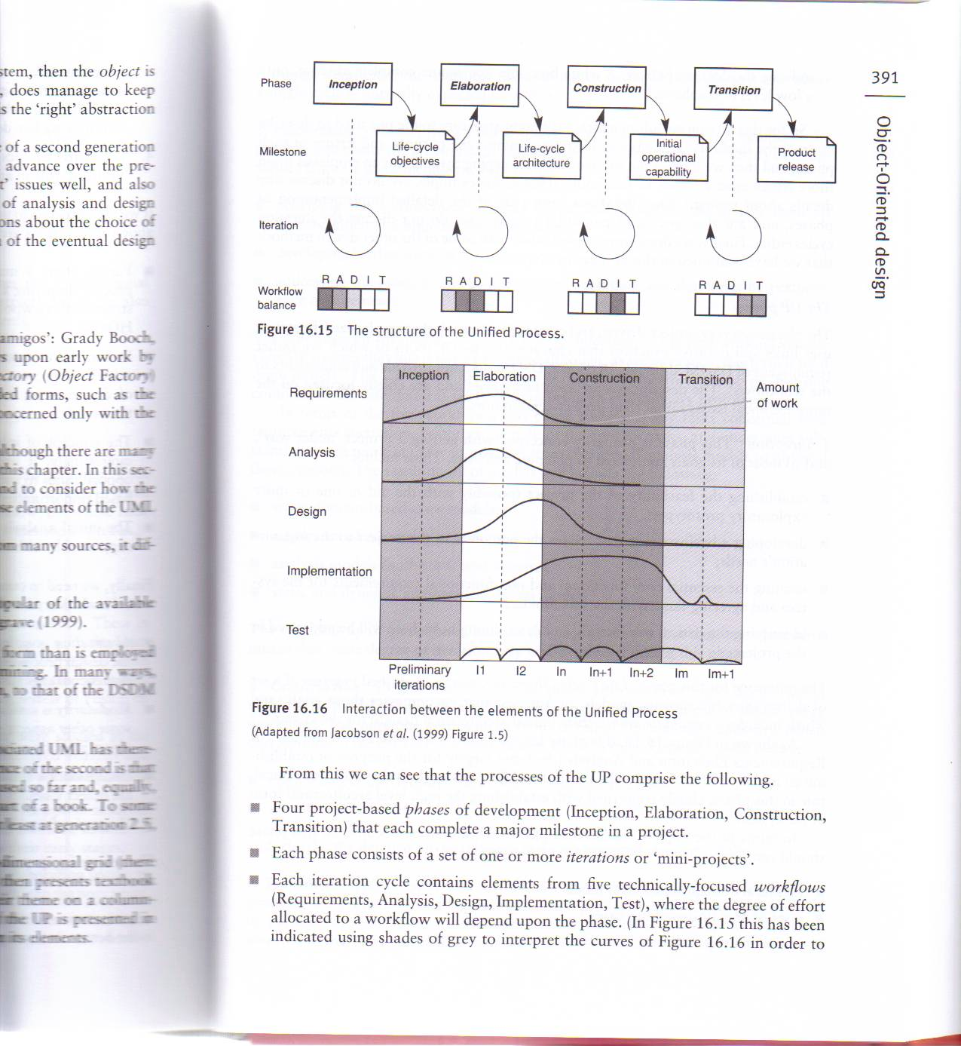
Overview of OO Design: Design process
Unified process

Slide 41
Overview of OO Design: Heuristics
Design patterns
Solutions to recurring design problems and for sharing design expertise in an application-independent fashion
Alexandrian form of representation of design patterns:
Name,
Context and problem statement,
Solution
Examples
Discussion on how the pattern relates to other patterns
Catalogues of design patterns:
Gang of Four catalogue (E. Gamma, R. Helm, R. Johnson, and J. Vlissides. Design Patterns - Elements of Reusable Object-Oriented Software. Addison-Wesley, 1995.
Java Design patterns.

Slide 42
Further Readings
[1] Zhu, H., Software Design methodology. Chapter 3 (design principles).
[2] Budgen, D, Software Design, Addison-Wesley, 1994. Chapter 1~ 3 (design process), Chapter 8 (design methods), Chapter 9 (design strategies).
[3] Bernard Witt, Terry Baker and Everett Merritt, Software Architecture and Design, Van Nostrand Reinhold, New York, 1994, Chapter 1~2, pp1~35. (the principles of software design).
Reading material:
A case study of object oriented design using design patterns (GoF, Chapter 2)

